Slide 1
Vending Machine
Team VendTech
Masrur Jamil Prochchhod
Mehedi Hasan
Pisula Guruge

Slide 2
Contents
Implementation on FPGA
Code
FSM Diagram
PCB Design

Slide 3
Hardware
Nexys Artix 7 100t FPGA

Slide 4
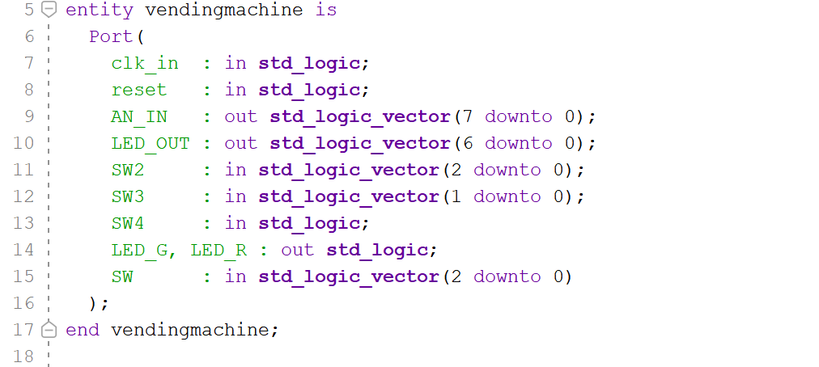
VHDL Code

Slide 5
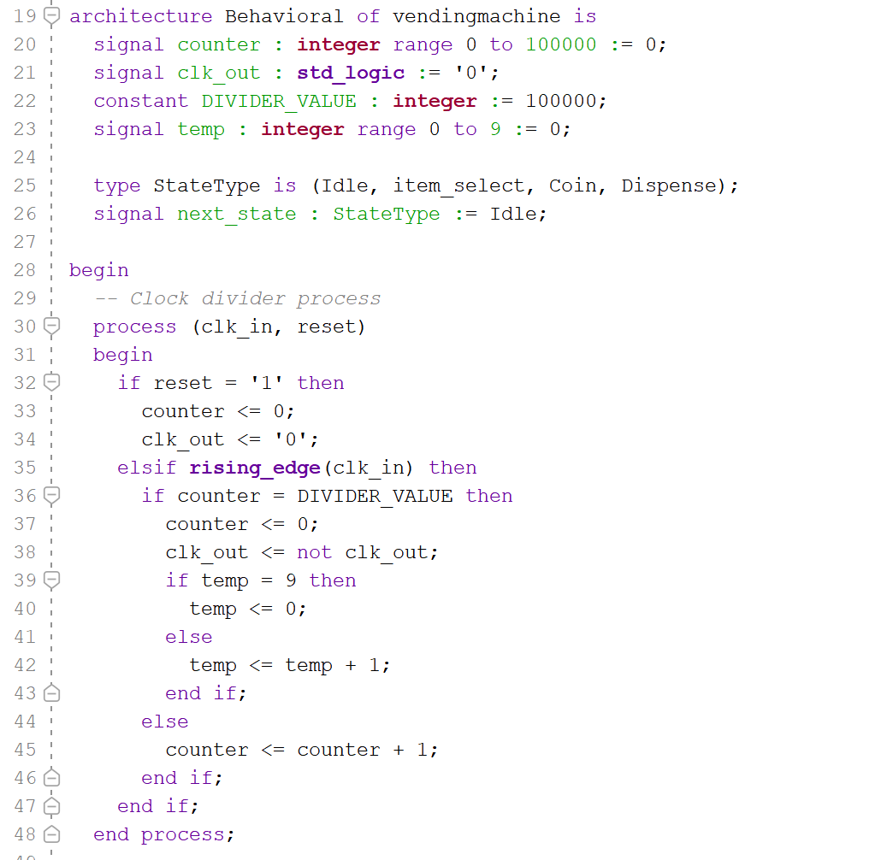

Slide 6
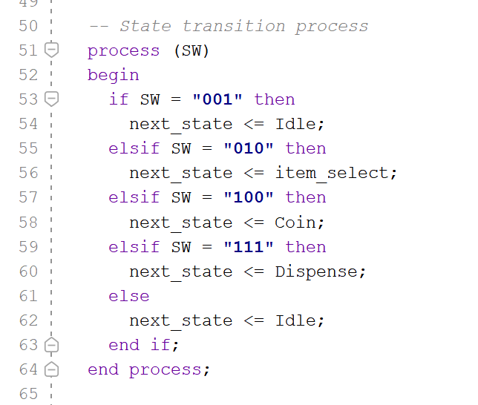

Slide 7
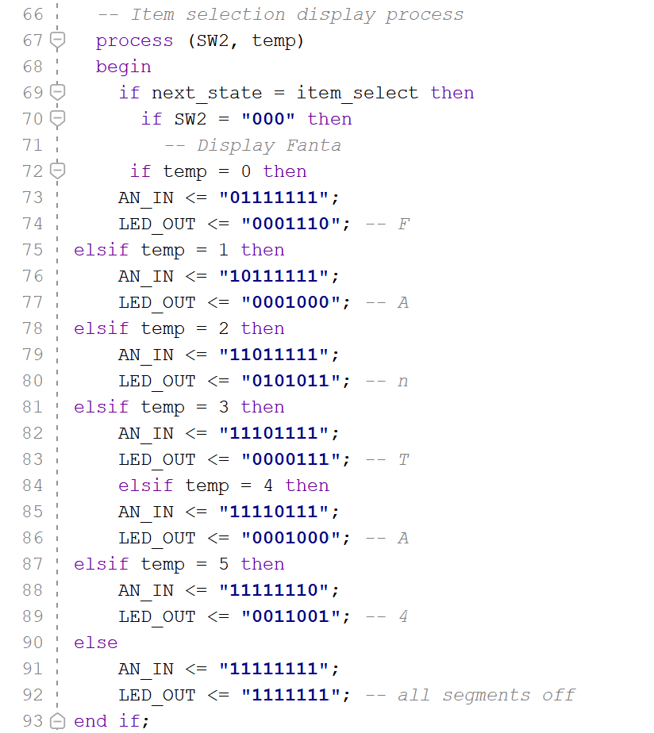
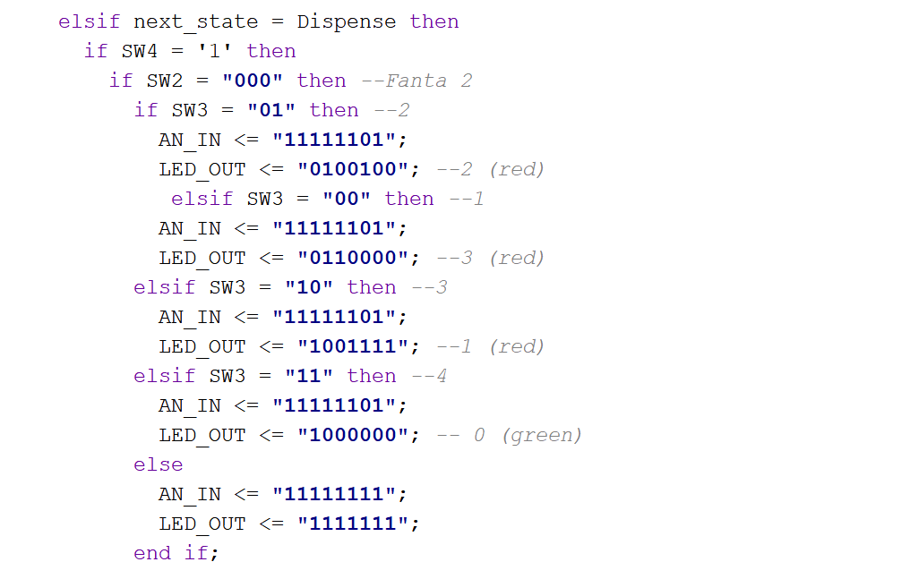

Slide 8
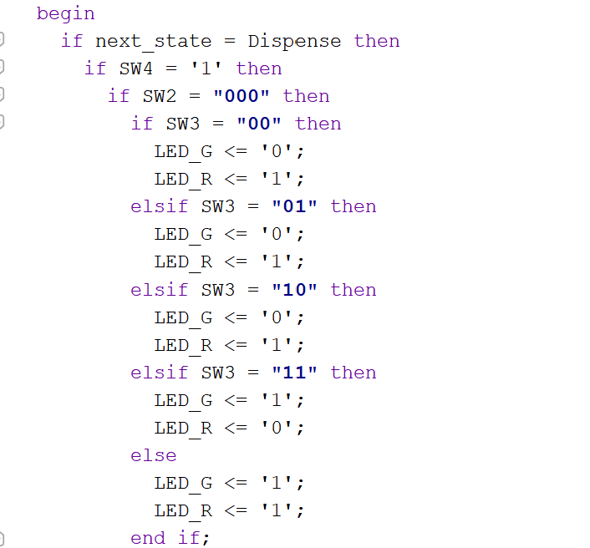

Slide 9
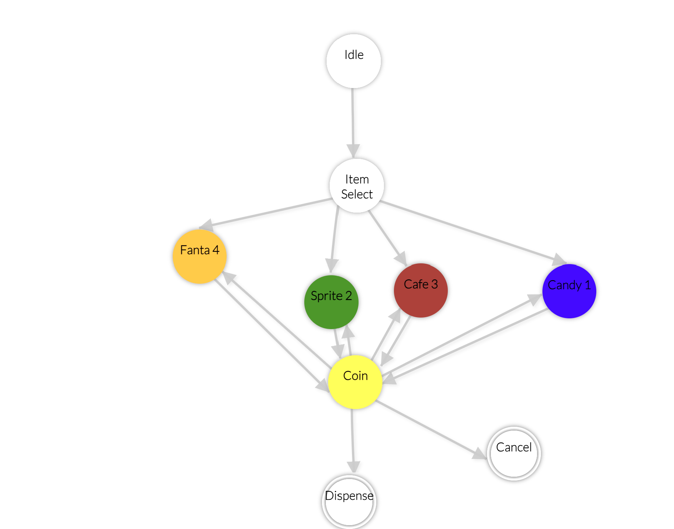
Finite State Model Diagram

Slide 10
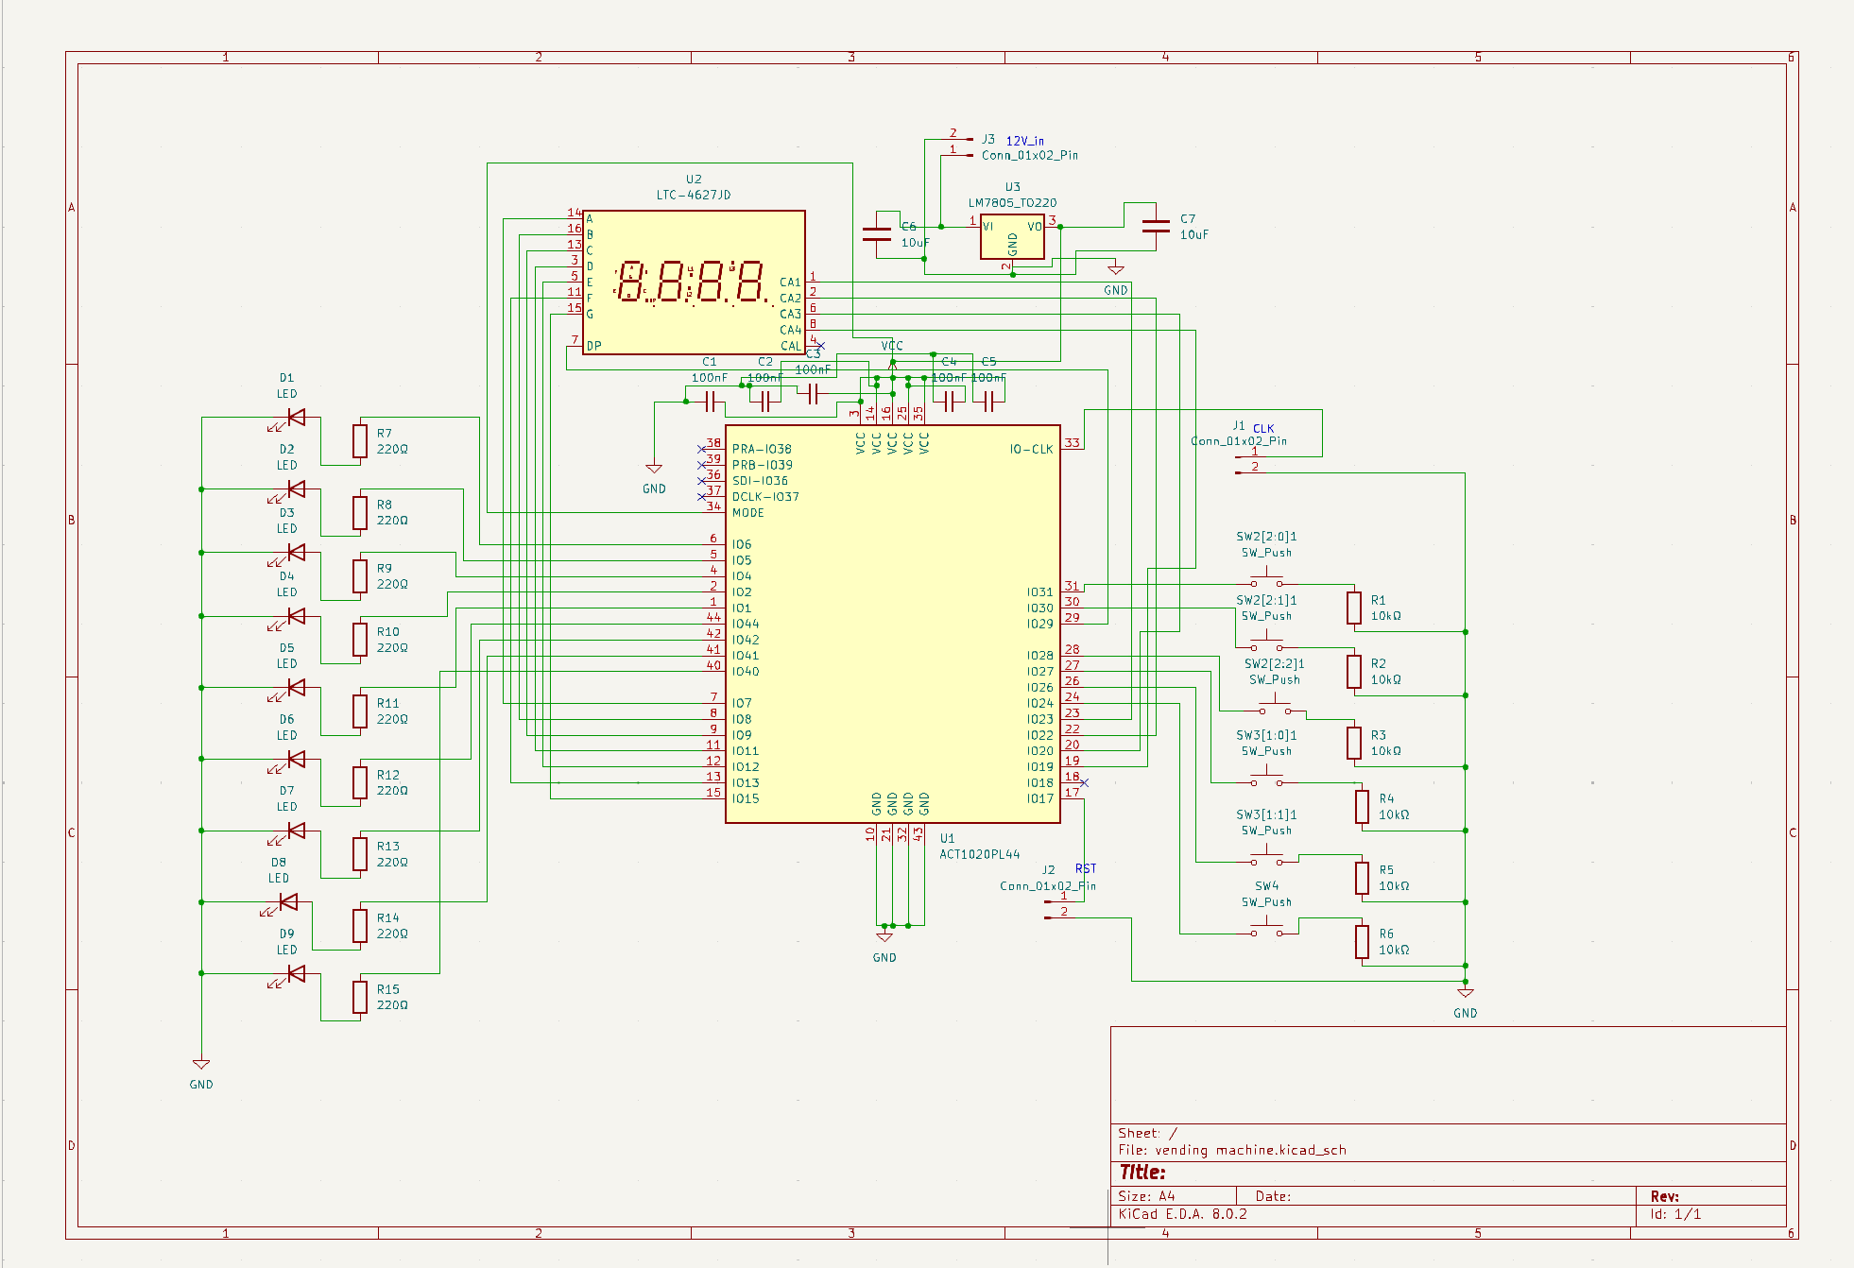
PCB Design
Schematic Design

Slide 11
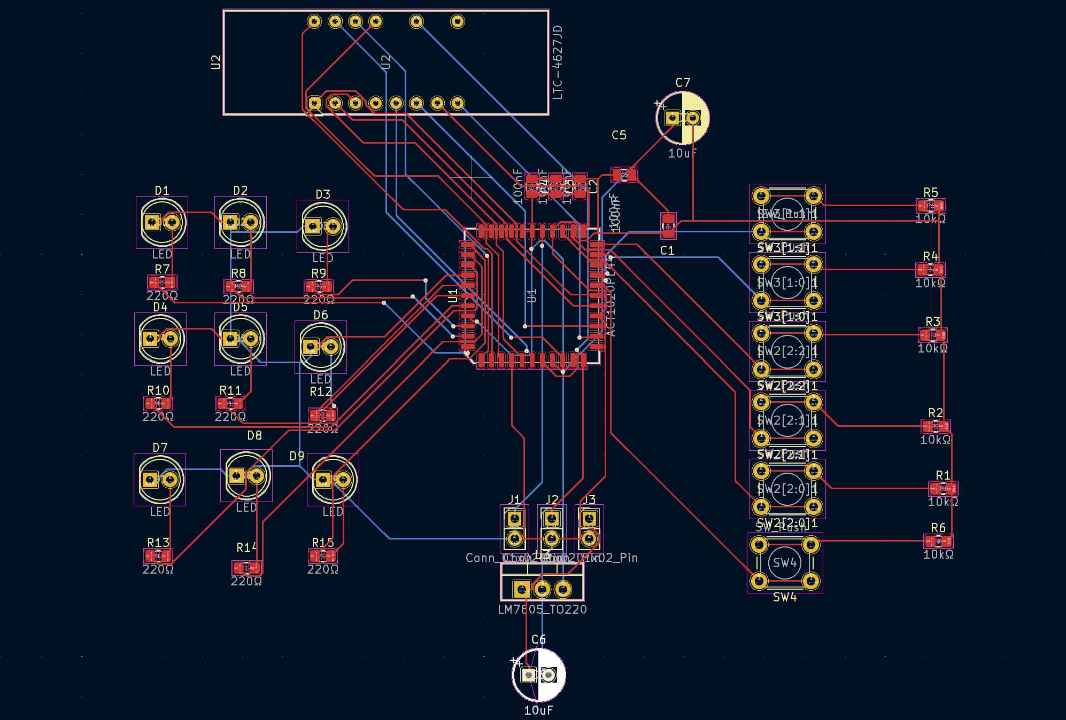
PCB Board

Slide 12
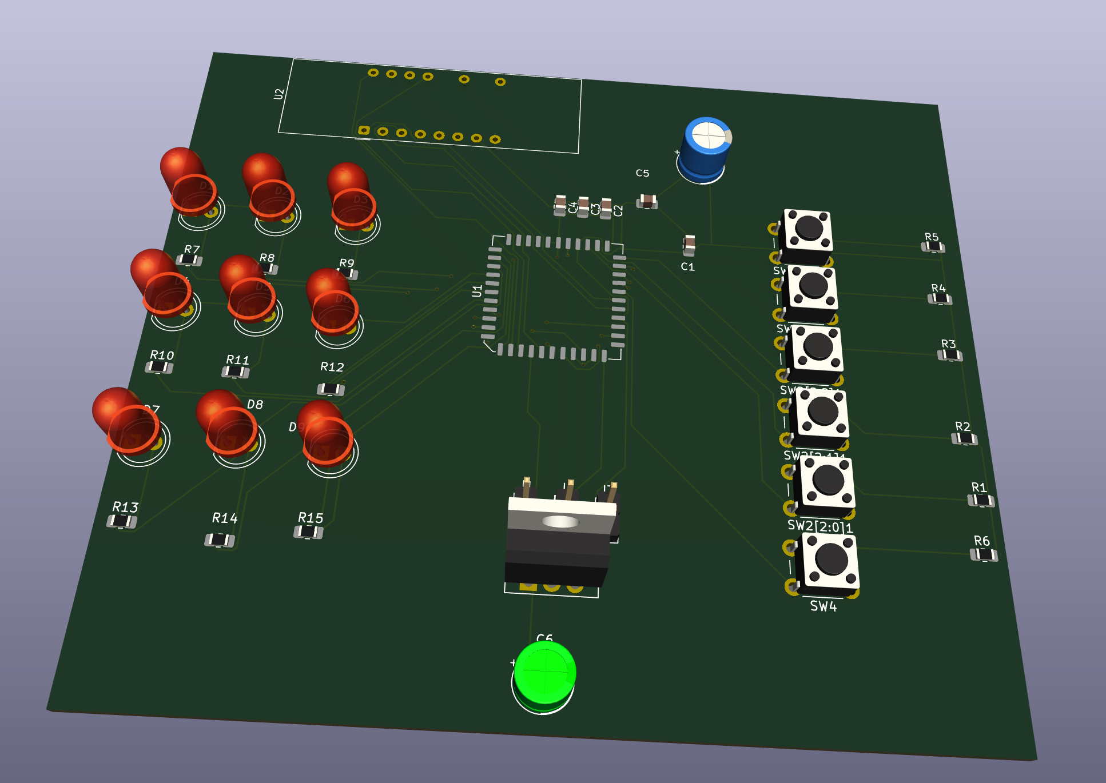
3D View of PCB Board

Slide 13
THANK YOU

